Slide 1

HOME ELEGANZ
E-commerce Assignment
2023/12/21
TEAM 1
Sahil, Shishir, Navraj, Medha, Arshdeep

Slide 2
Team Members
Sahil Rajbhandari (Project/Git Manager)
Developers:
Shishir Shrestha
Navraj Kaler
Medha Meduri
Arshdeep Sandhu

Slide 3

INTRODUCTION
Home Eleganz is an innovative home decor platform designed to transform any living space into a place of beauty and comfort. Our website is a one-stop destination for all home decoration needs, offering a wide range of products that blend contemporary design with functionality. We believe that everyone deserves a home that reflects their personal style and values.

Slide 4

Mission Statement
Our mission is to empower homeowners by providing them with high-quality, stylish, and affordable home decor options. We strive to make home decorating an accessible and enjoyable experience for everyone, regardless of their budget or design expertise.

Slide 5
Vision for Home Decoration
At Home Eleganz, we envision a world where every home is a sanctuary of elegance and personal expression. We are committed to leading the home decor industry with innovative designs, sustainability, and an unparalleled customer experience. Our vision is to inspire and enable homeowners to create spaces that tell their stories, nurture their well-being, and bring joy to everyday living.

Slide 6

OVERVIEW
Home Eleganz's website is a digital embodiment of our brand's ethos: combining elegance with practicality. The website serves as a digital showroom, idea incubator, and shopping destination, providing users with an immersive experience that captures the essence of their dream home.

Slide 7
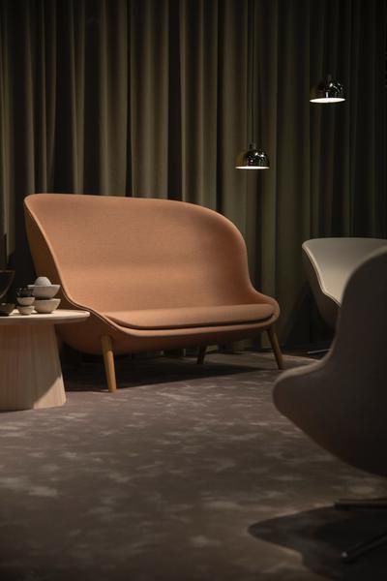
KEY FEATURES OF THE WEBSITE
User-Friendly Interface: A clean, intuitive, and responsive design ensures easy navigation, allowing users to find what they need swiftly.
Extensive Product Catalogue: Users can browse an extensive range of home decor items, from furniture to accents, all categorized for convenience.
Visual Inspiration: A gallery full of home decor ideas inspires users to visualize the potential of their spaces.
Personalized Recommendations: Advanced algorithms suggest products based on users' browsing patterns and preferences.
Secure Payment Gateway: A robust and secure payment system provides users with a safe and seamless checkout experience.
Customer Dashboard: Registered users have access to a personal dashboard for order tracking, wish lists, and customized alerts.

Slide 8
SERVER
Software Installed:
- Operating System: Ubuntu Server (Version 2.14)
- Web Server: Apache HTTP Server (Version 2.4.52)
- Programming Language: PHP (Version 8.2.0)
- Database Management System: MySQL(MySQL PDO Driver)
SSH Setup: Configured SSH connections using the .ssh/config file.
Website Directory Setup: Configured directories for website hosting (/var/www/mysites/site/homeeleganz).
Installed and configured the required server software components:
- Apache HTTP Server for web hosting
- PHP and its necessary extensions for server-side scripting
- MySQL Server for database management
- Restarted the Apache service for the changes to take effect.
- Installed Certbot and obtained SSL certificates to secure communications over HTTPS.
Deployment Setup:
- Configured the server to pull updates from Git (git pull).
- Executed npm run build for deploying the frontend changes.

Slide 9
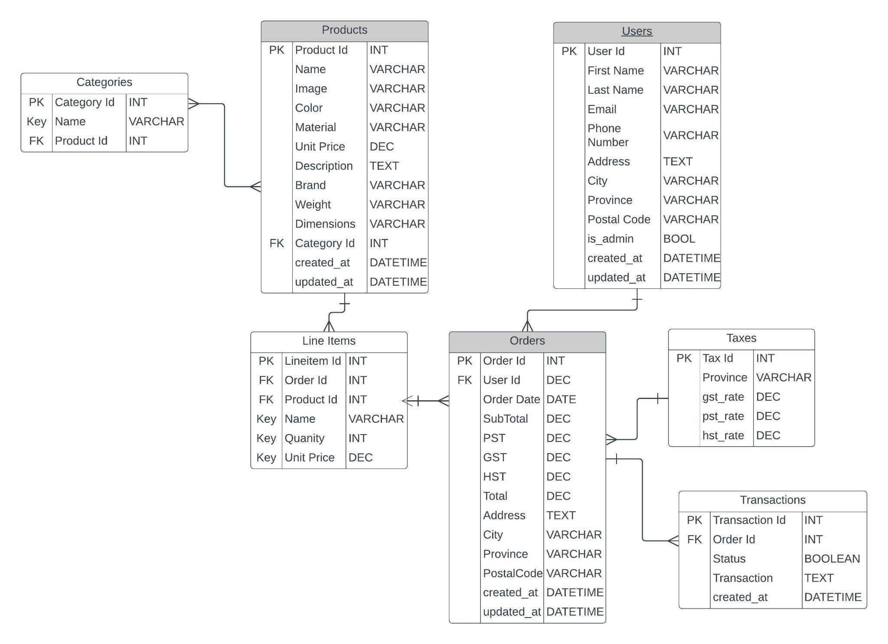
Entity Relationship Diagram

Slide 10
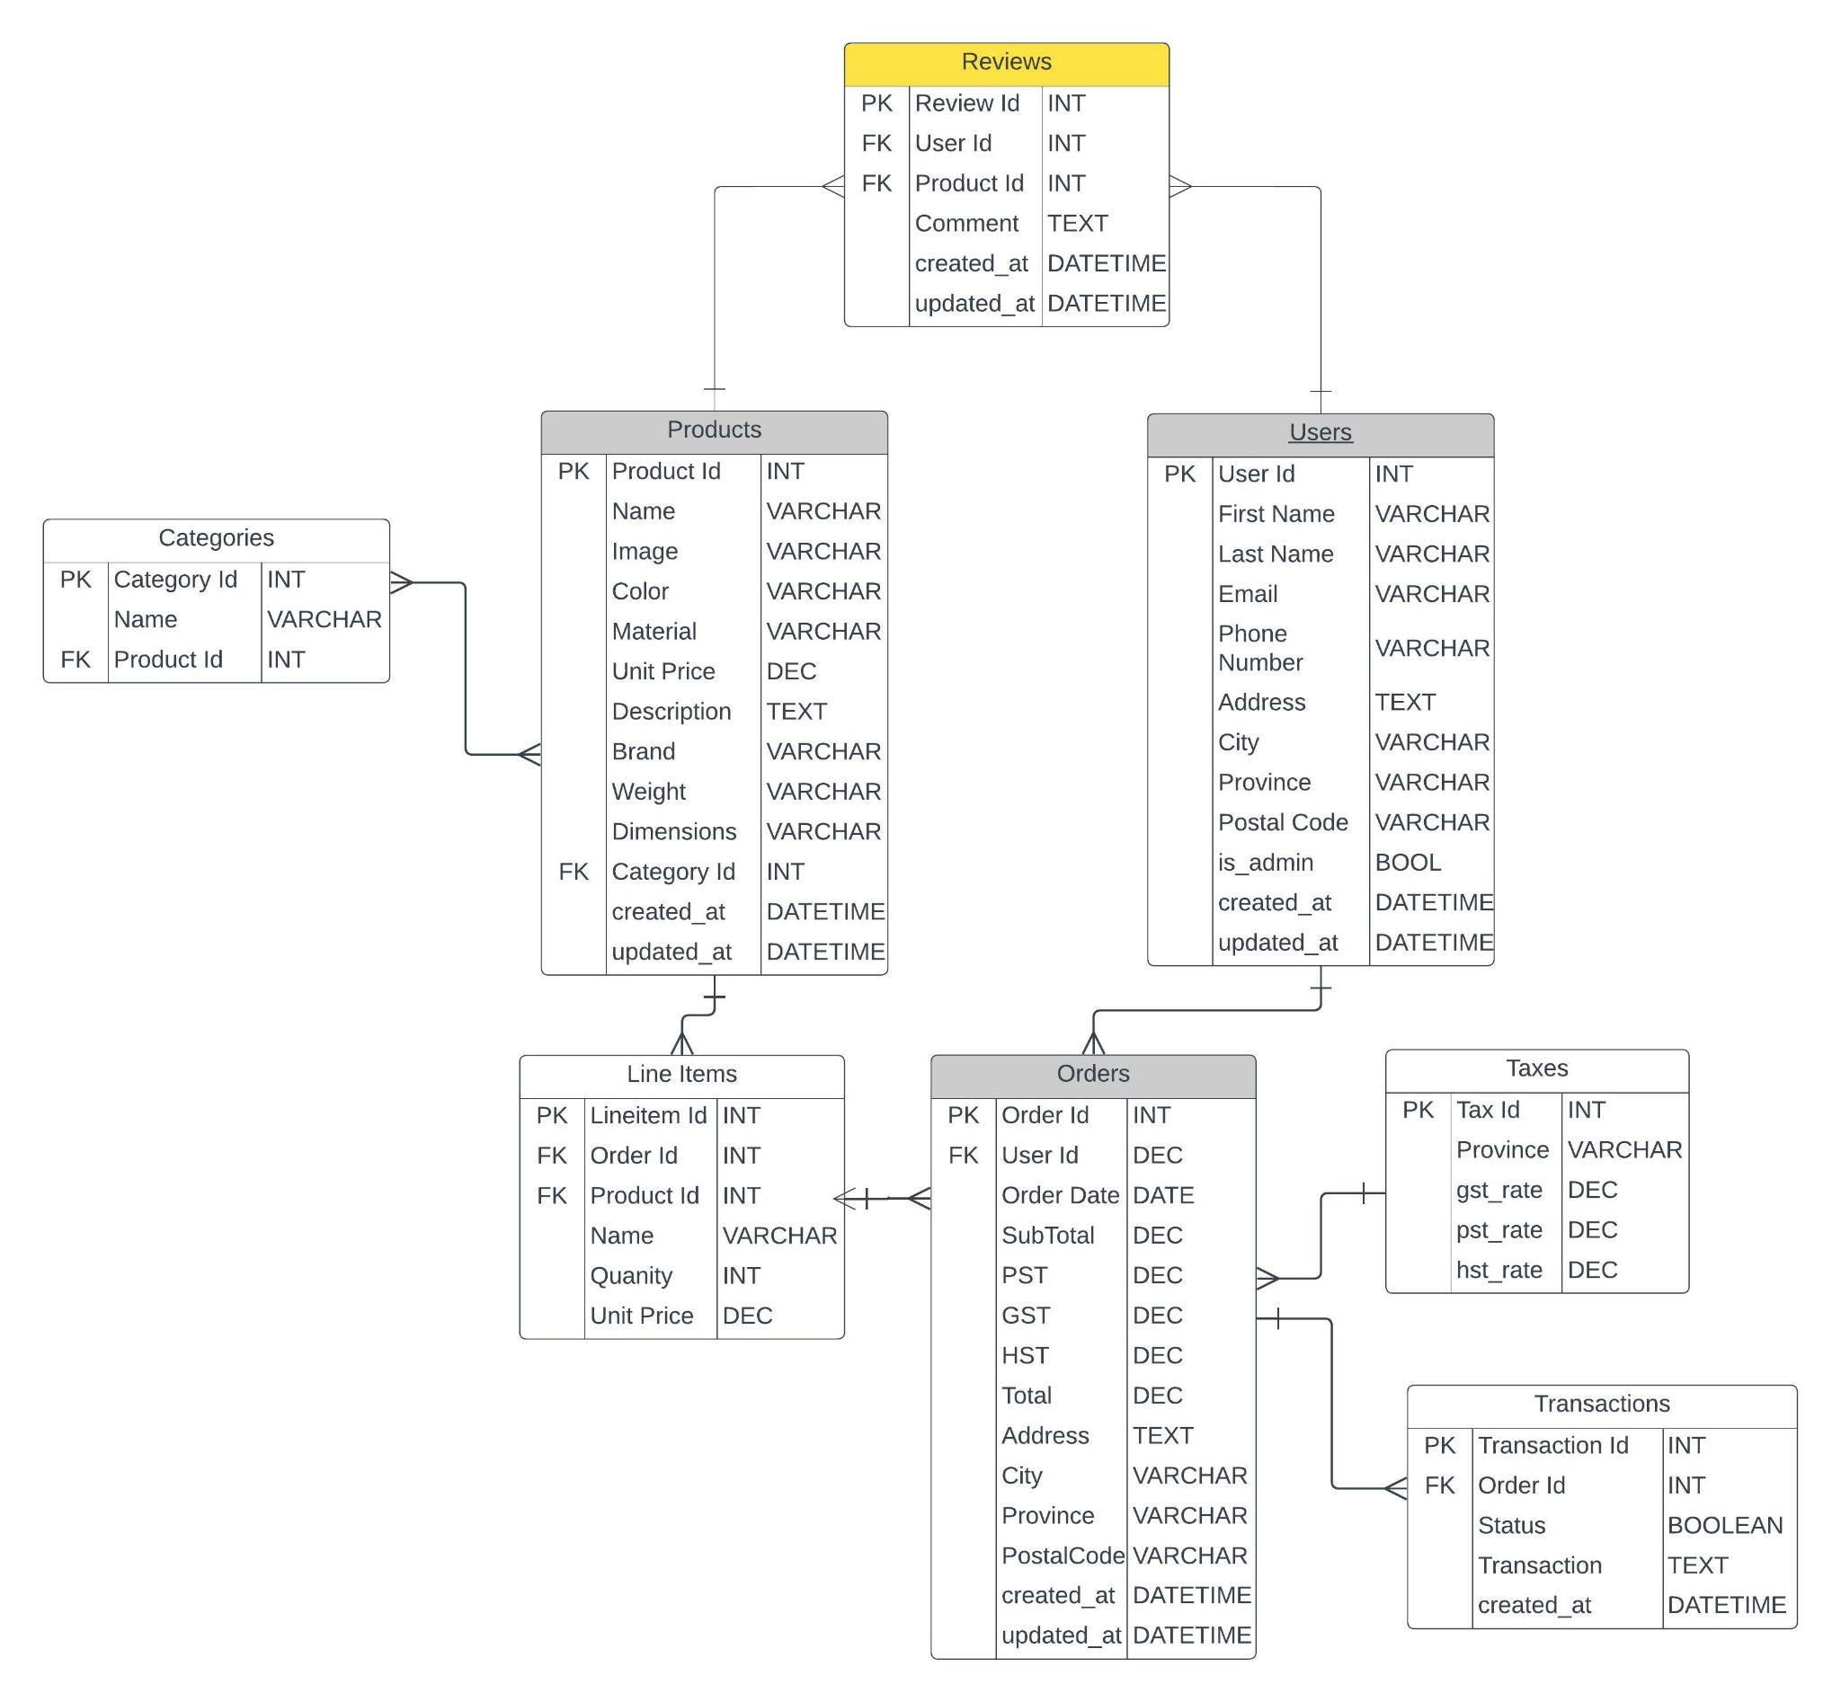
Entity Relationship Diagram

Slide 11
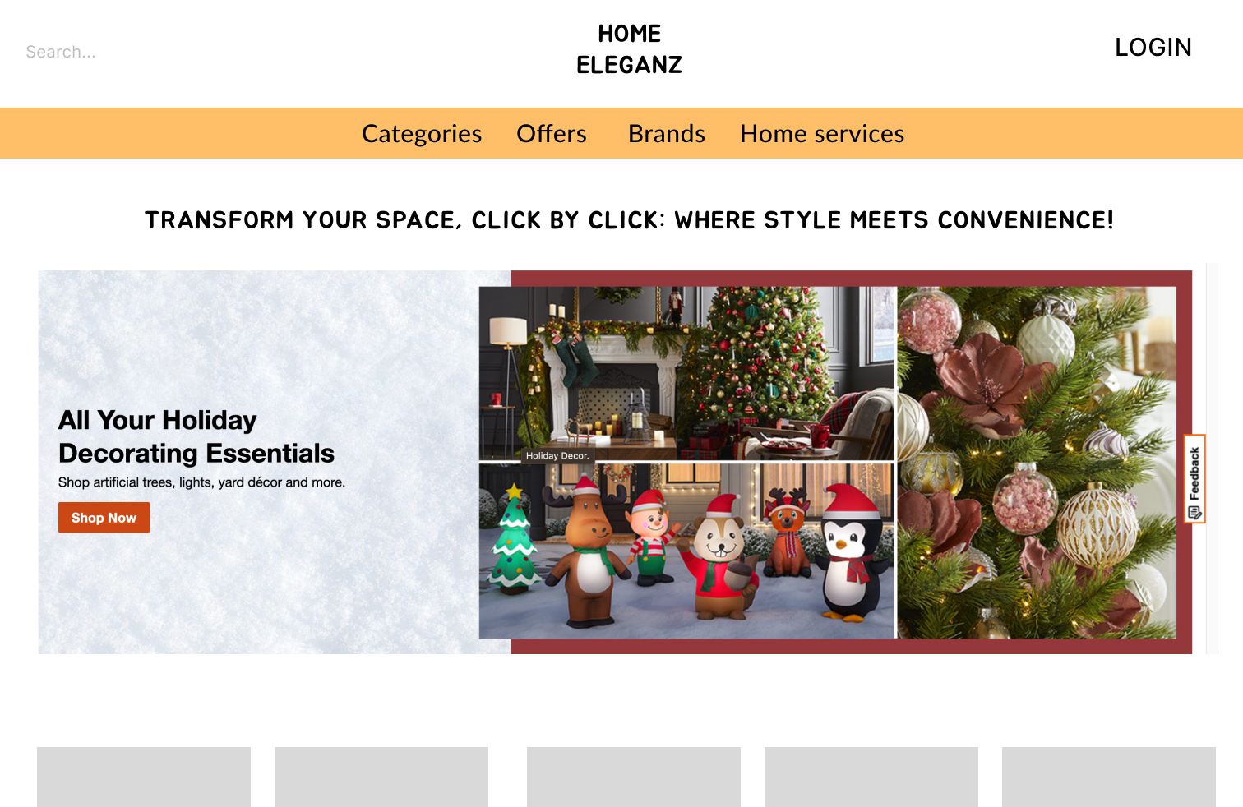
PROPOSED DESIGN HOMEPAGE

Slide 12
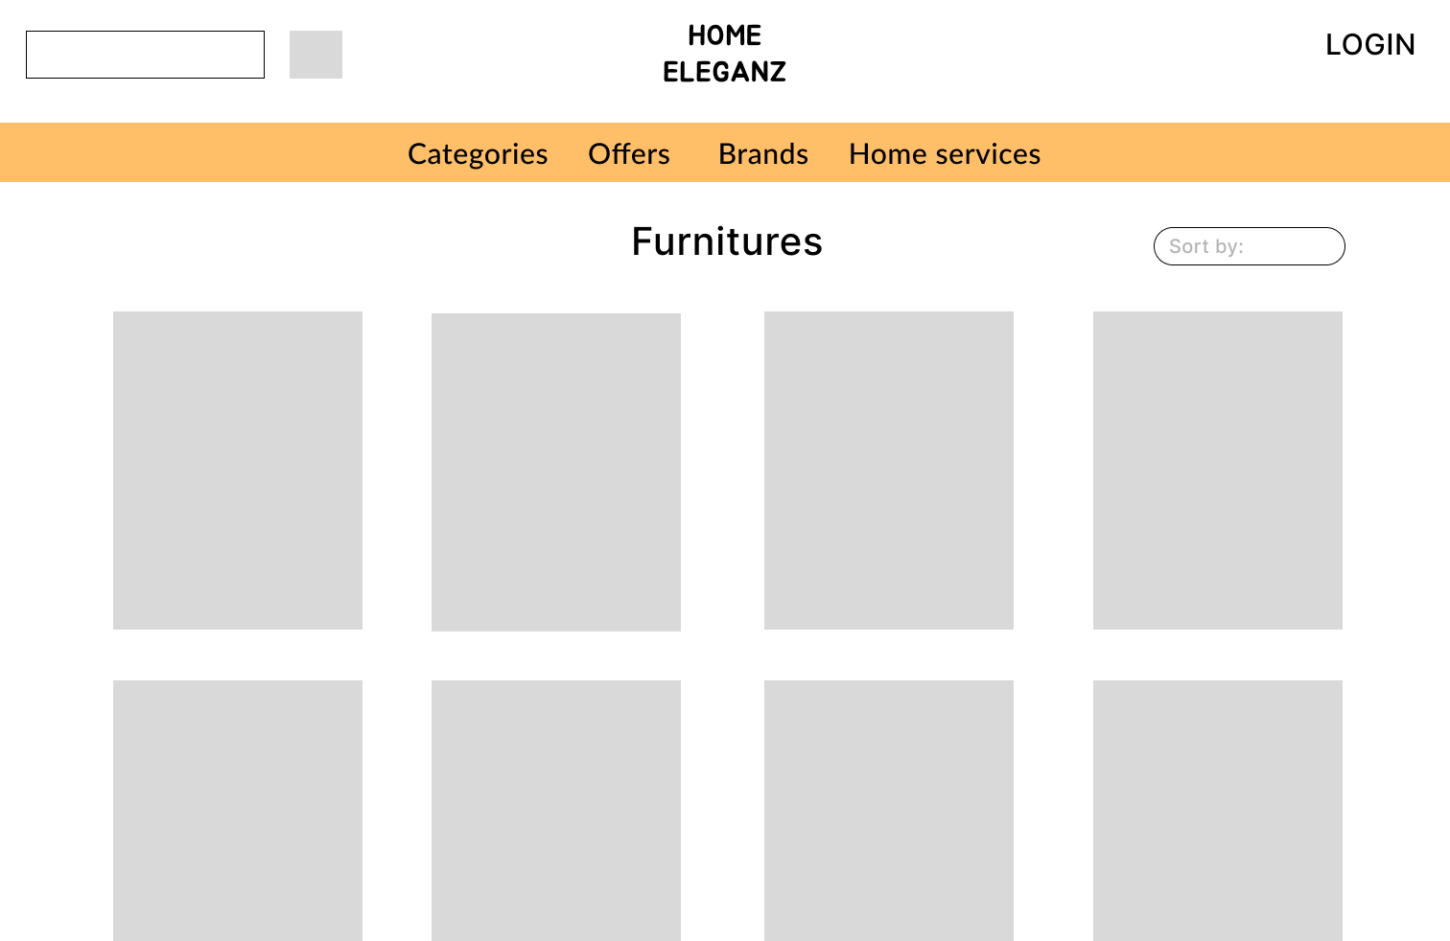
PROPOSED DESIGN LIST VIEW
‹#›

Slide 13
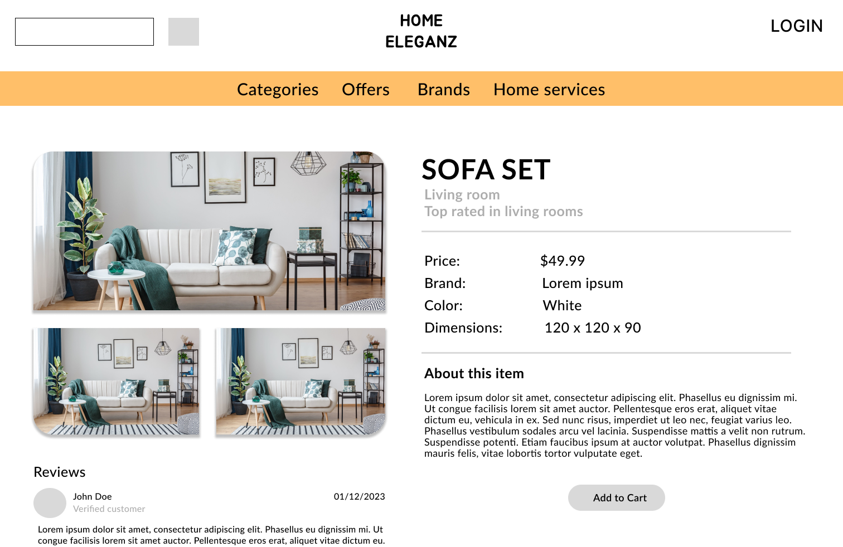
PROPOSED DESIGN DETAIL VIEW
‹#›

Slide 14
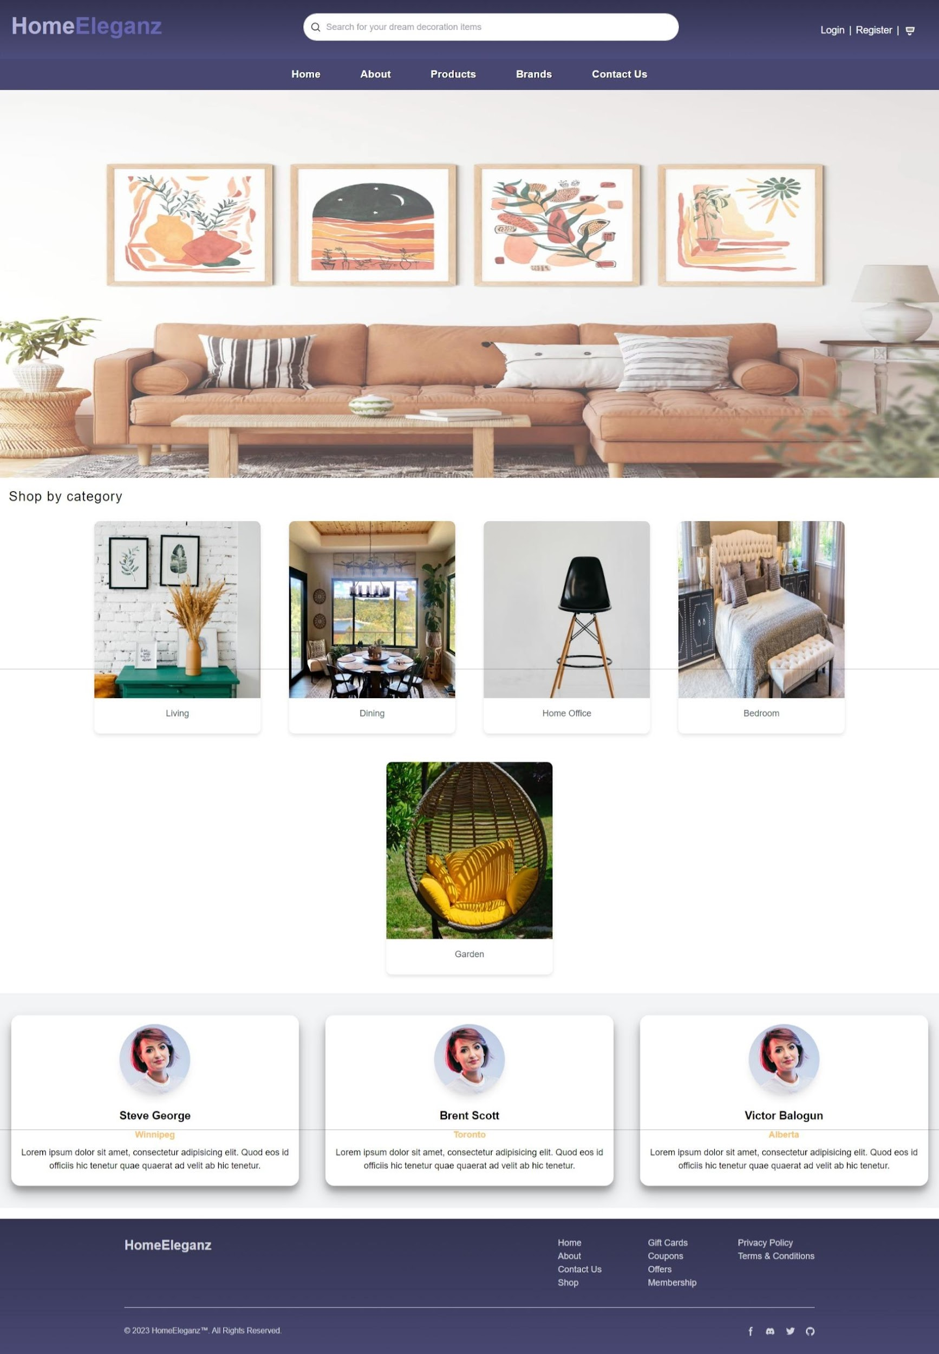
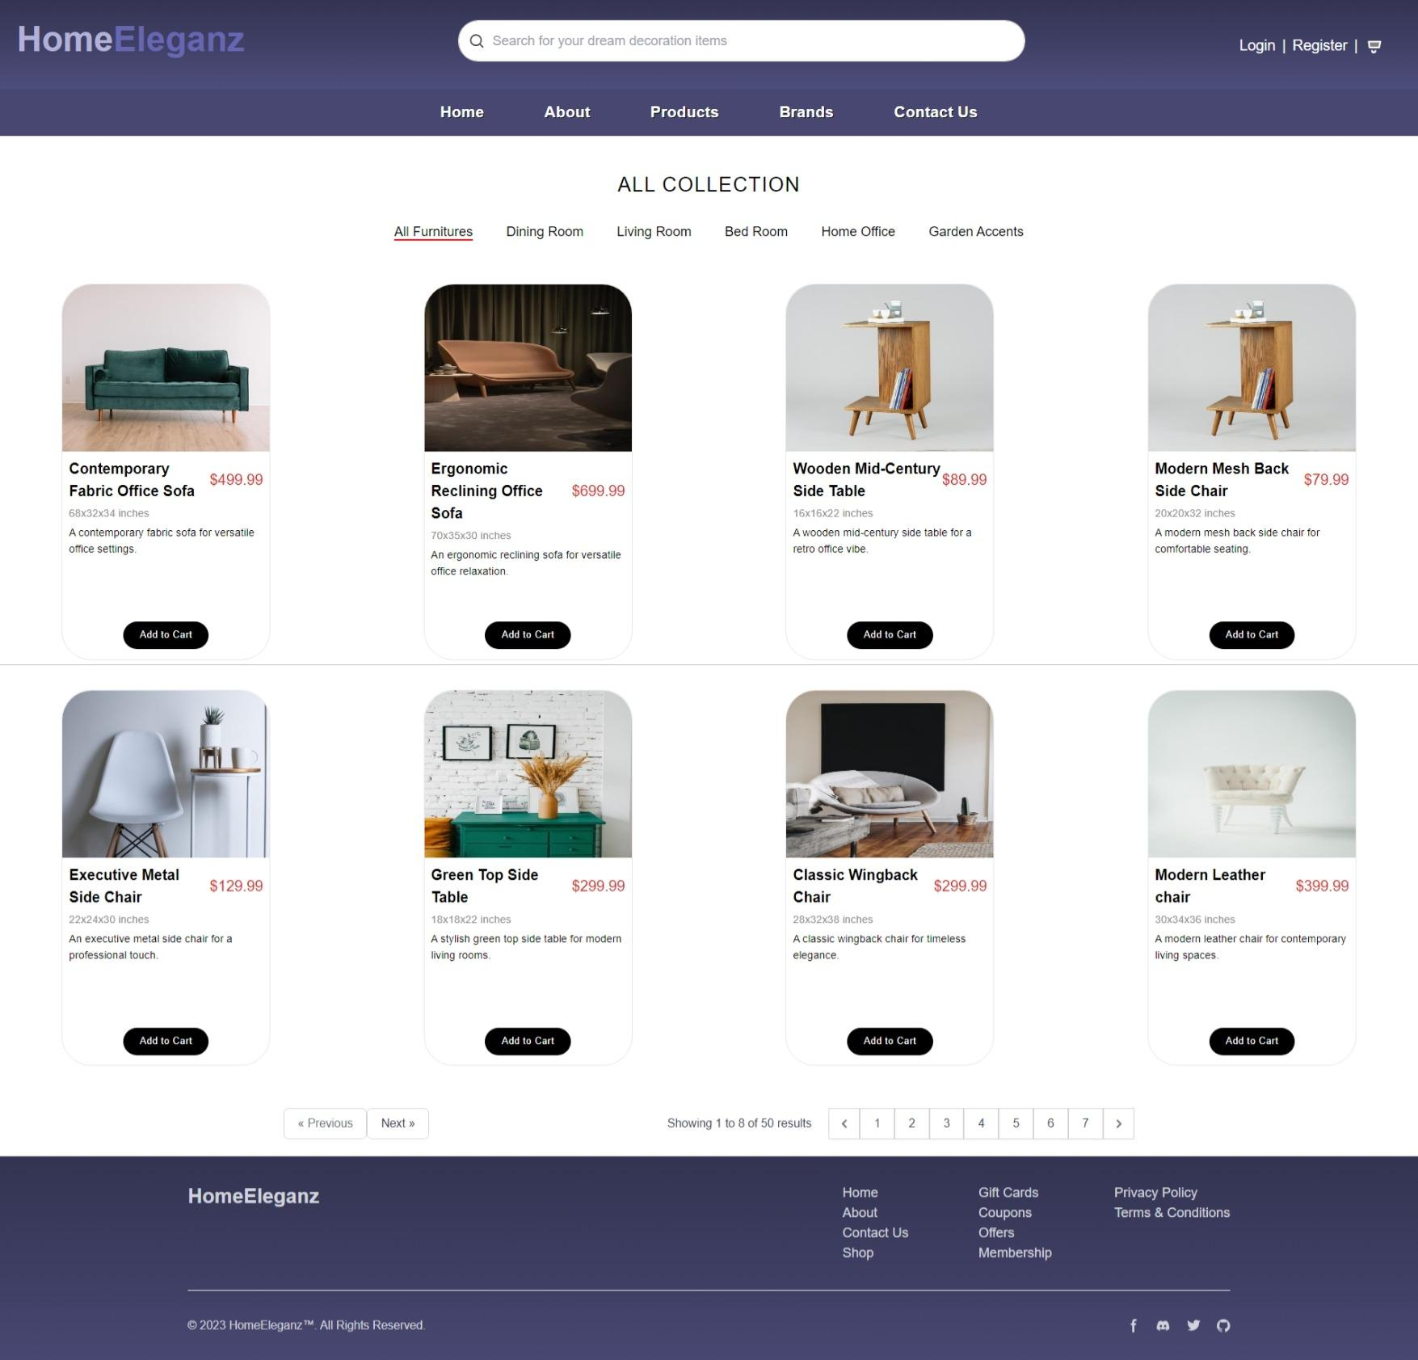
PRODUCTS PAGE
HOME PAGE
‹#›
‹#›

Slide 15
PRODUCTS PAGE
LIST VIEW
‹#›

Slide 16
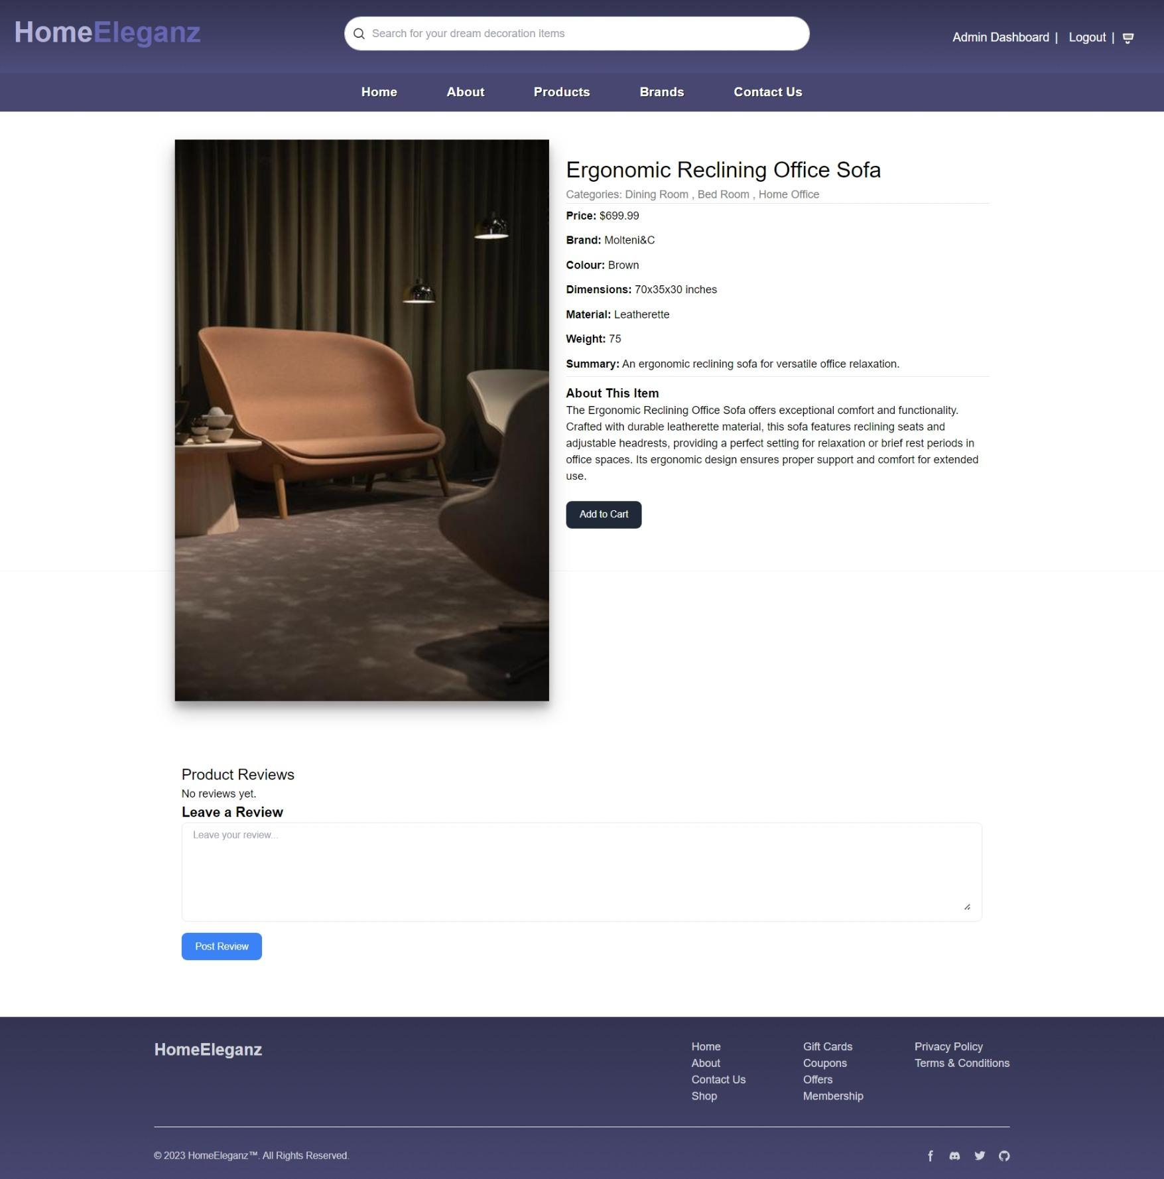
DETAIL VIEW

Slide 17
EXPERIENCE - CREATING HTML/CSS FOR DESIGN

Slide 18
Site Walkthrough

